Slide 1

Affiliated to Visvesvaraya Technological University, Belagavi.
Approved By AICTE, New Delhi.
Recognized by UGC with 2(f) & 12(B) status.
Accredited by NBA and NAAC
PRESENTATION TO DEMONSTRATE MOBILE PHONE HOLDER FOR PROJECT EXPO
TEAM MEMBERS
1. APARNA A PATIL [1MJ21CS021]
2. KRUTHIKA H.S [1MJ21CS093]
3. MAHI NARESH HEGDE[1MJ21CS104]
4. SUPREETHA VIKRAM[1MJ21CS219]
An Autonomous Institute Affiliated to VTU Belagavi, Approved by AICTE ,Recognized by UGC with2(f)&12(b) ,Accredited by NBA & NAAC

Slide 2
INTRODUCTION
A study by the university of Texas at Austin found that smart phones demand our attention even when they are not in use. Mobiles are used by everyone frequently due to this mobile accessory will attract attention of the people so we chose mobile holder project. Even if there are different accessories for phones, mobile holder are the real winners. A stand keeps you organized and gives your hand a break. It can do a lot for your phones safety it will prevent your phone from damage cause due to various reasons. Mobile phone holders are easy to use and they give a lot of comfort to the users helping them to focus in their work. Phone stands are small objects that are used to prop up your device.
Mobile holders provide a warranty of safety, when a consumer purchases a device for long-term usage that is also pricey, the warranty should never be overlooked. It may never have crossed your mind, but having a specific place to put your phone or tablet every day can make your life easier. More than 600 million people of India own a smartphone. 91.5% of people feel uneasy leaving their phone at home.45% of smartphone owners accidentally damage their phones at some point. A phone stand, case, or holder gives them a safe place to put their device. People touch their phones on average 2,617 times per day.76.5% of people admit to being addicted to their cell phones. 70% of YouTube views come from mobile devices. It’s easier to watch those videos if you can do it hands free. 47% of people say they can’t live without their mobile device.
An Autonomous Institute Affiliated to VTU Belagavi, Approved by AICTE ,Recognized by UGC with2(f)&12(b) ,Accredited by NBA & NAAC

Slide 3
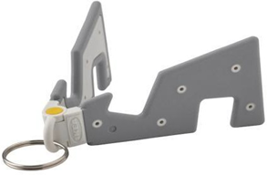
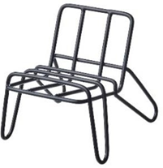
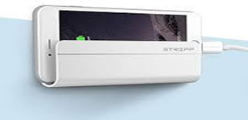
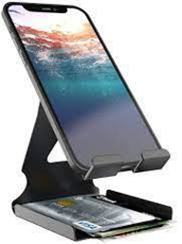
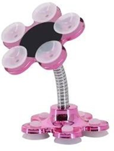
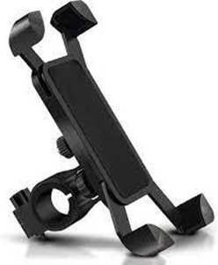
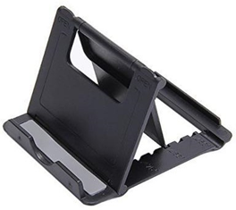
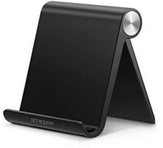
SURVEY
The following are the present available products in market.

Slide 4
NOVELTY
With this survey we got to know several advantages and disadvantages of the mobile holder products which are currently available in market. We have also found out that Silicon material is not compatible for the manufacture of mobile phone holders hence we used pine wood as our base material for our product as it is light weighted which makes it easy to carry our products around and we used strong adhesive agents like sound 43 .The finished products were given a natural polish to highlight the woody texture of our product.
We created two products our first model is study table friendly it helps you save place on your study table as it provides an extra compartment for all your stationary items. The second model is portable consumers can carry it around without any difficulty.

Slide 5
PROTOTYPE
1.Select wood which is convenient for the product.
2.Measure it and cut it using a saw.
3.Scrape the wood to make it smooth, and to give it a proper texture.
4.Attach the wood using adhesive like A43(helps in faster adhesion),fevicol etc.
5.Leave it to dry
6.Blunt the edges to prevent from cutting your hand.
7.Give it a finishing touch by polishing
8.The adhesive mostly preferred is A43.
9.The cutting was done using a machine.
10.Natural polishing will be given for the product to enhance the woody texture.
11.For the second model small hinges were used to make it foldable and portable.

Slide 6
WORKING
The dimensions of our first product was found using simple Pythagoras theorem. We were able to create our first product in a way in which it did not occupy a lot of space on study table at the same time included an extra compartment to store stationary and other required items.
We wanted to create another model which is more portable and easy to carry around and hence we created a model just like a pencil case which makes it easy to carry around.

Slide 7
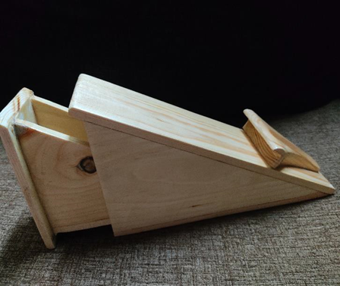
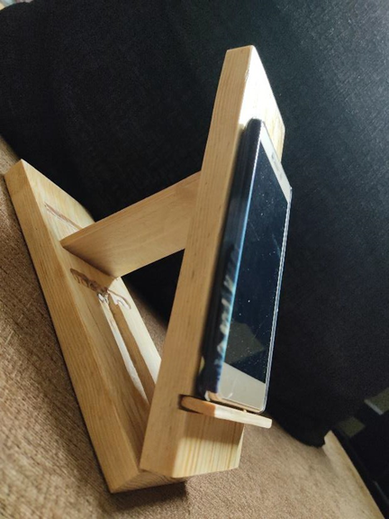
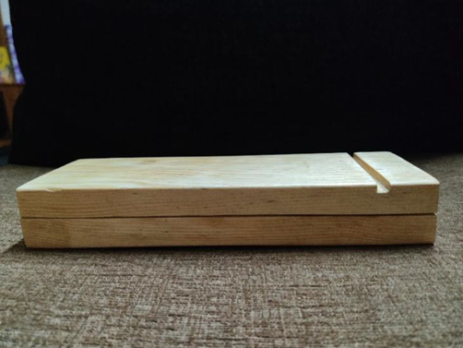
Finished product
[Model 1] [Model 2]
An Autonomous Institute Affiliated to VTU Belagavi, Approved by AICTE ,Recognized by UGC with2(f)&12(b) ,Accredited by NBA & NAAC

Slide 8
IMPACT
In today’s market there are many mobile holders but what makes our product unique is it has a compartment for electronic gadgets like earphones, charger etc. It is stable and durable. We used pine wood for our product which makes our product light and strong.
Both our models are unique the first model has a compartment inside which helps the user to keep electronic gadgets, pencils, pens etc. Our second model does not have an extra compartment like the first product but it is more compact compared to our first model. Therefore, according to the need of the consumer our products can be used
The created models made out of wood and it lasts longer compared to other materials. It is portable and provides extra compartment for the charger and other necessary gadgets required for your phone. Unlike other phone holders which used silicon as base material we have used pine wood hence our product is eco friendly
Customers liked our first model which had extra compartment
Carpenter liked our ideas and is ready to manufacture more of these products
An Autonomous Institute Affiliated to VTU Belagavi, Approved by AICTE ,Recognized by UGC with2(f)&12(b) ,Accredited by NBA & NAAC

Slide 9
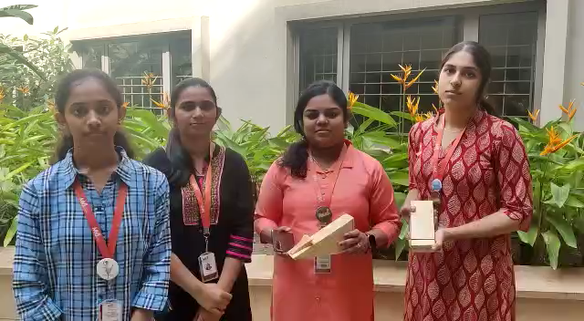
DEMONSTRATION OF PROTOTYPE

